Slide 1
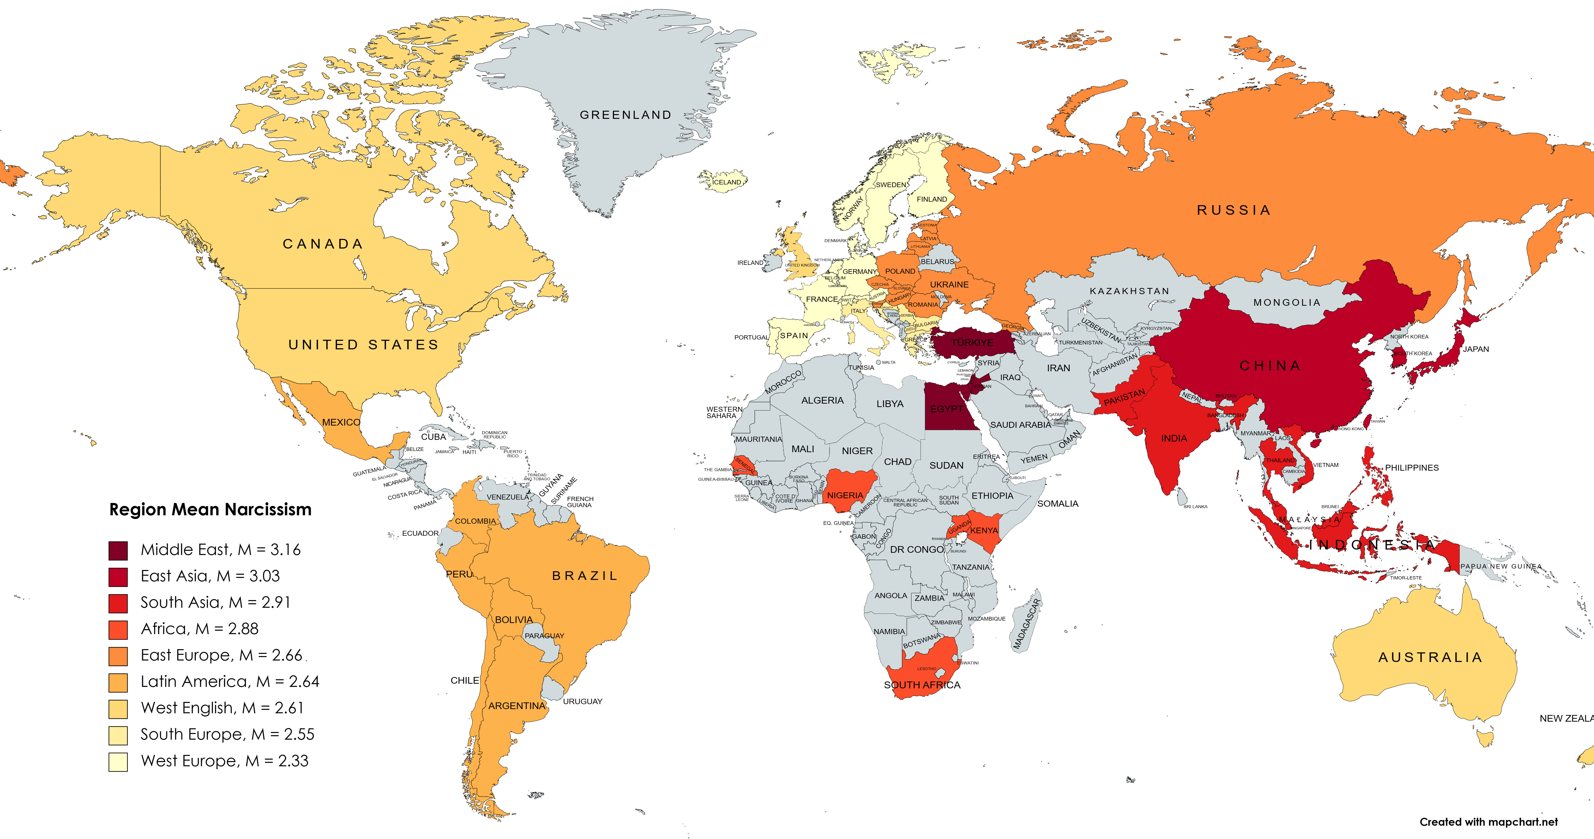


Cross-Regional Narcissism
Christina Fischer & Dr. Erica Baranski
California State University, East Bay
Introduction
Past research on narcissism has focused on the differences between independent and interdependent cultures, typically looking at only two cultures or countries to be compared. We extend this work by assessing relations between narcissism and interdependent vs independent self-construal among individuals across over 60 countries. We also extended previous research and assessed cross-regional differences in mean narcissism levels. Finally, we explored relations between narcissism and self-construal among individuals across these regions.
Method
Data for this endeavor comes from the International Situations Project in which over 15,000 participants from 63 countries completed a series of individual difference measures.
Narcissism was measured by the NARQ
Self-construal and its two facets were measured by the Self-Construal Scale:
    Self-interest (independence) vs harmony (interdependence)
    Self-expression (independence) vs commitment to others (interdependence).
Results
The results indicate that Western Europe has the lowest average narcissism (M = 2.33, SD = 0.66) and the Middle East has the highest (M = 3.16, SD = 0.68).
Across all regions, those who scored high in narcissism also scored high in the self-interest facet of independent self-construal (overall r = .24). Interestingly, there was no relationship between narcissism and the self-expression facet of self-construal (overall r = .01).
Discussion
These findings illuminate the differences in narcissism across regions and how the self-interest facet of independent self-construal may play a role in this variation.
Self-Interest Construal
Self-Expression Construal
Traits/Facets | r
Narcissism | .24
Admiration seeking | .25
Rivalry | .18
Traits/Facets | r
Narcissism | .01
Admiration seeking | -.02
Rivalry | .03
Matilda’s parents were both narcissists.

