Slide 1
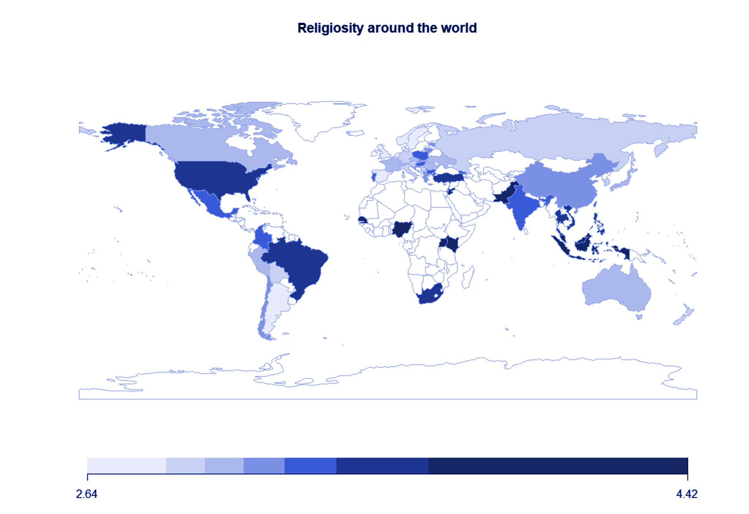







Religion and Personality:
Explorations of the variability of personality & religiosity links across religious affiliations.
Eve Simpson-Allen, Dr. Erica Baranski
California State University, East Bay
INTRODUCTION
While the connection between personality and religiosity has long been a topic of interest, few studies have assessed variability in these relations across religions. To fill this gap, we related the Big Five personality traits, their facets, and other traits relevant to individuals’ perspective of the world to religiosity. We then assess the variability of these relations across seven major religious affiliations.
RESULTS
Religiosity was positively related to conscientiousness and the fairness facet of honesty/humility.
Religiosity was negatively related to modesty, and self-interest self-construal.
There was variability in these relationships across religions: religiosity for those practicing Buddhism was positively related to openness and trust yet negatively related for those practicing Hinduism.
Religiosity among Buddhist participants was positively related to social status, yet negatively related for those practicing Judaism and Islam.
Religiosity among Jewish participants was positively related to modesty, yet negatively related for Buddhist and Christian participants.
METHOD
The current project utilized data from the International Situations Project in which 14,132 college students from 61 countries reported on their Big Five personality traits, honesty/humility, self-construal, and religiosity (“How religious are you on a scale from 1 to 10”). Participants also indicated whether they followed a religion, and if yes, reported what religion they practice.
DISCUSSION
These results illuminate the value of evaluating each religion, rather than grouping religiosity together, when assessing the relations between religiosity and individual differences.
Religiosity Around the World
Religiosity
Personality Traits | r
Conscientiousness | .18
Fairness | .18
Subjective Happiness | .15
Modesty | -.15
Self-Interest | -.14
Depression | -.11
Hinduism
Personality Traits | r
Trust | -.13
Greed | -.12
Openness | -.11
Conscientiousness | .08
Self-Expression | .08
Honesty | -.08
Islam
Personality Traits | r
Conscientiousness | .24
Negative Emotionality | -.15
Subjective Hap. | .14
Depression | -.12
Interdependent Happiness | .11
Social Status | -.10
Judaism
Personality Traits | r
Sincerity | .20
Conscientiousness | .18
Self-Interest | -.18
Honesty | .17
Social Status | -.17
Agreeableness | .15
Modesty | .15
Subjective Happiness | .15
Fairness | .12
Christianity – Unspec.
Personality Traits | r
Subjective Happiness | .13
Fairness | .13
Honesty | .11
Modesty | -.09
Openness | .08
Christian Orthodox
Personality Traits | r
Agreeableness | .16
Fairness | .14
Interdependent Happiness | .13
Self-Interest | -.13
Tightness | -.12
Subjective Happiness | .12
Catholicism
Personality Traits | r
Fairness | .11
Honesty | .09
Conscientiousness | .08
Extraversion | .08
Subjective Happiness | .08
Buddhism
Personality Traits | r
Greed | .20
Openness | .15
Social Status | .12
Modesty | -.12
Trust | .11
Fairness | .11

