Slide 1
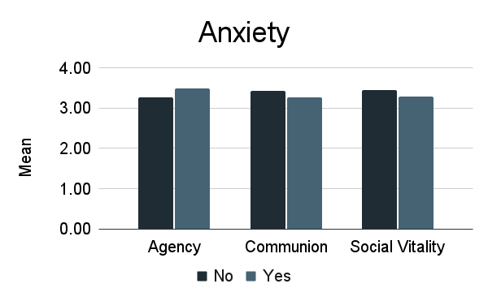
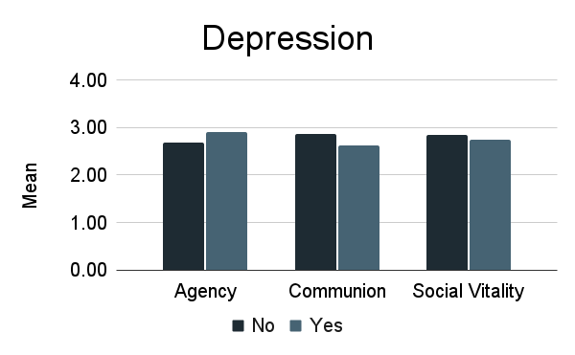
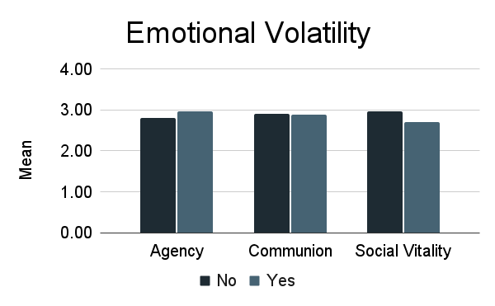
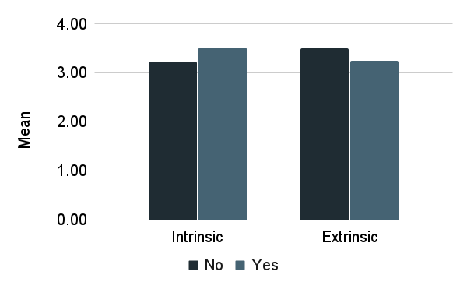
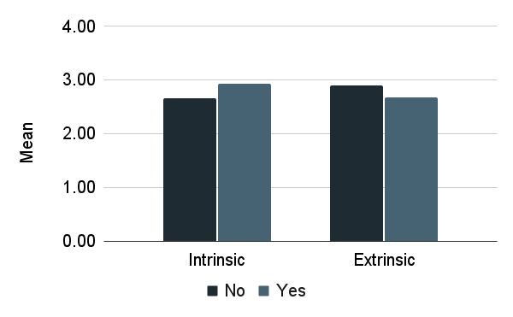
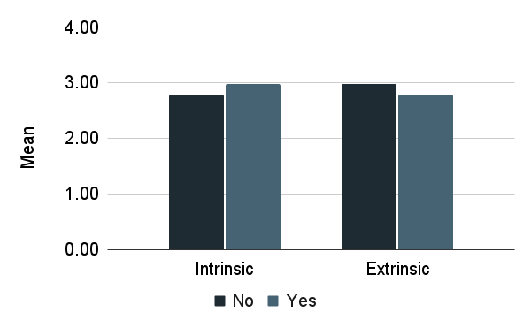
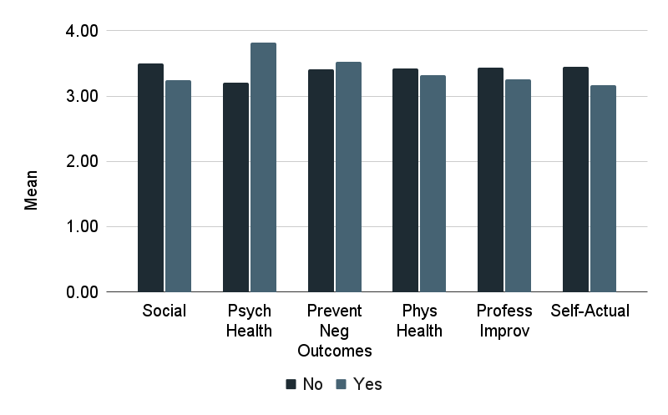
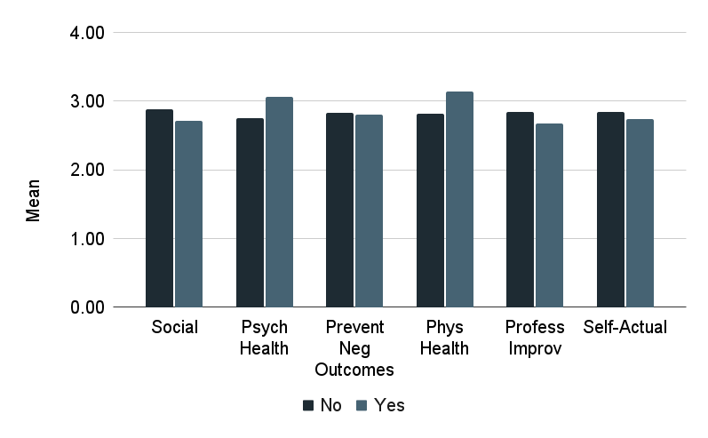
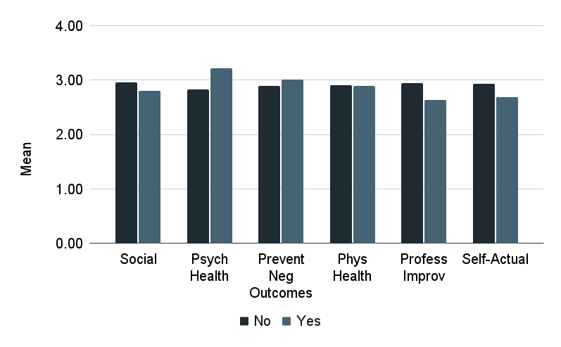
Motivations of People with Anxiety & Depression
Stephanie Mauer, Eve Simpson-Allen, Dr. Erica Baranski
California State University, East Bay
Introduction
Method
Previous research has shown mixed results in assessing the impact of anxiety and depression on goal pursuit. The current study seeks to help resolve this ambiguity by focusing on types of motivation in the pursuit of self-improvement goals.
*
*
*
Analysis was conducted on data collected from the Houston Occupational and Personality Study (HOPS). Graduating seniors from three geographically diverse universities (N = 718) completed a series of measures including the Big Five, Personality Inventory, and reported whether they wanted to change their personalities and what their motivation was to make this change. These responses were then coded along categories representing agency vs. communion, intrinsic vs. extrinsic, and context (e.g., social, psychological health, professional).
*
*
Results
People high in anxiety are more likely to be motivated for agentic (t = 2.83, p < .001) and intrinsic reasons (t = 3.64, p < .001) or to improve their psychological health (t = 5.85, p < .001relative to those with a any other type of motivation. Those high in anxiety are also less likely to change for extrinsic reasons or to improve their professional circumstances.
*
*
*
*
*
*
People high in depression are more likely to be motivated for agentic (t = 2.61, p < .001), intrinsic (t = 3.00, p < .001), psychological (t = 3.14, p <.001), physical (t = 1.53, p = .15) improvement relative to those who want to change for any other purpose. Those high in depression are also less likely to change for extrinsic purposes or to improve social circumstances.
Discussion
These results underscore the power of mental health’s effects on goal pursuit and illuminate the value of understanding how people with higher anxiety and depression are motivated to change themselves. Mental health practitioners could use this information to tailor goal-pursuit language and approaches to potentially tap into their anxious and depressed clients’ motivations for change.
* *
*
*
* *
*
People high in emotional volatility are more likely to be motivated for agentic (t = 2.01, p < .00) and intrinsic (t = 2.20, p = 0.03) purposes and to improve psychological health (t = 3.97, p < .001) relative to people with a goal to change for any other purpose. Those high in emotional volatility are also less likely to change for extrinsic purposes or to improve professional circumstances.

