Slide 1


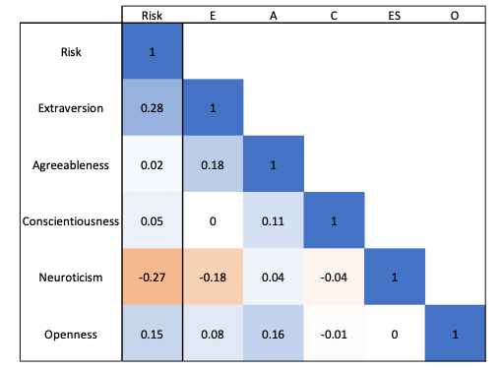
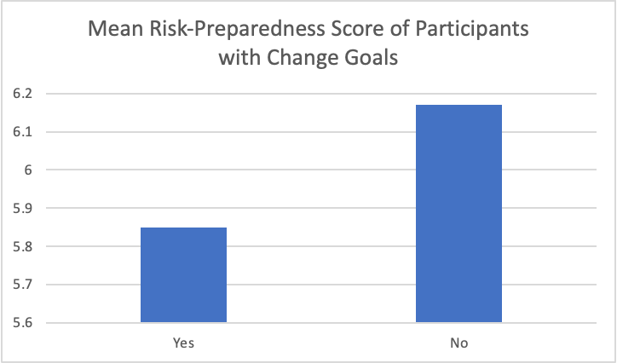
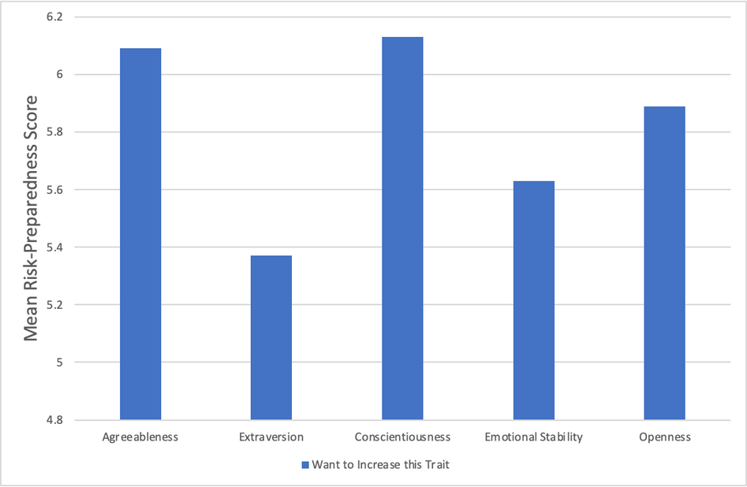


Risk Preparedness and Personality Change: Evaluating the Role of Risk-Taking in Pursuing Personality Change Goals
Josephine C. M. Fealy, Min Zheng, Erica Baranski
California State University, East Bay
Distribution of the Risk Preparedness Scores
Risk-Preparedness and Personality Traits
Results
  The majority of participants (63%) report High Risk-Preparedness.
  Participants with personality trait change goals have lower risk-propensity (M = 5.85).
  There was a difference in Risk-Preparedness scores between those who do and do not have personality trait change goals, (t (8.29), p <.001).
  High-Risk individuals want to increase Agreeableness and Conscientiousness.
  Low-Risk individuals want to increase Extraversion and Emotional Stability.
  High-Risk is correlated with higher self-perception of Change Goal success (r = .22, p <.001).
  High-Risk is correlated with higher self-reported Happiness measures; SHS (r = .30, p <.001), IHS (r = .18, p <.001).
Discussion
  Low-Risk individuals may have goals to increase Extraversion and Emotional Stability because they may allow those individuals to feel more comfortable with risks such as “putting yourself out there.”
  High-Risk individuals may have goals to increase Agreeableness and Conscientiousness, more other-focused traits, because they already feel content with their levels of Extraversion and Emotional Stability, more self-focused traits.
  High-Risk individuals accounted for a smaller proportion of those with trait-change goals. This may be because those individuals already feel they have accomplished their trait change goals, or are more content with their current personality.
  The correlation between self-reported risk-propensity with both perceived change-goal success and measures of happiness may indicate that risk-propensity is an essential component in pursuing self improvement goals.
Future Directions
  Examine Risk-Preparedness by participant country of origin.
  Look for moderating factors of risk-preparedness and trait change goals.
  Measures differences in self-report outcomes between High and Low risk groups.
  Analyze relationship between perceived change-goal success and measured trait change.
Introduction
Risk is one of the measure factors when it comes to making decisions. Previous research on risk focuses on negative behaviors and outcomes (eg. gambling, driving without a seatbelt, and mania-induced behaviors). But can risk-taking positively benefit self-improvement?
The current project focuses on self-reported propensity towards taking risks, decontextualized from behaviors. We explored the relationship between risk and other variables, including:
  What is the relationship between Risk-Preparedness and personality traits?
  What is the distribution of the Risk-Preparedness scores in our data?
  Who is more likely to have a change goal between high and low-risk participants?
  What is the relationship between Risk-Preparedness and personality change goals?
  Risk-Preparedness and other outcome measures.
Method
  Data was collected from a cross-cultural study, the International Situations Project. Participants (n = 13,279) from 63 countries aged between 16 - 67 years old (M = 21.69).
  Our study analyzed the relationships between Risk-Preparedness and Personality Traits, Change Goals, and Outcome.
  Measures:
    Risk- Preparedness: Risk-taking Behavior Item (Mata, Josef & Hertwig, 2016) measuring risk on a scale of 0 = Unwilling to take risks to 10 = Fully prepared to take risks
    Personality Traits: 60-item Big Five Inventory
    Subjective Happiness: Subjective Happiness Scale (SHS) (Lyubomirsky & Lepper, 1999)
    Interdependent Happiness: Interdependent Happiness Scale (IHS) (Hitokoto & Uchida, 2015)
What is the relationship between Risk-Preparedness and Personality Trait Change Goals?
*
How does Risk-Preparedness relate to self-reported outcome measures?
 | Perceived Change-Goal Success | SHS Happiness | IHS Happiness
r-value | .22 | .30 | .18
p-value | <.001 | <.001 | <.001
Contact Information and References
jfealy@horizon.csueastbay.edu
mzheng9@horizon.csueastbay.edu
erica.baranski@csueastbay.edu

