Slide 1
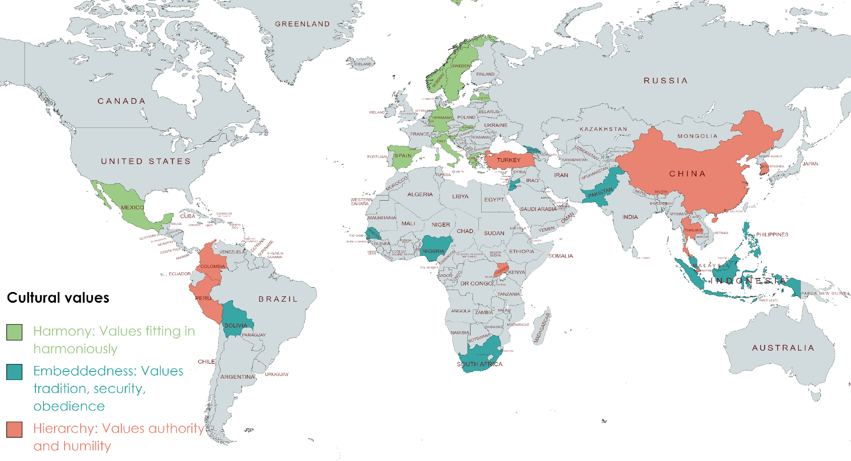


A Representative Assessment of the Relationships Between Schwartz’s Cultural Values and Individual Differences
Shams Aljuberi, Ashley Duarte, Erica Baranski,
California State University, East Bay
Introduction
Past research assessing cross-cultural differences of the Schwartz’s basic values focuses on mean-level comparisons and relations with the Big Five personality traits or other individual differences separately. Oftentimes the studies primarily focus on W.E.I.R.D. (Western, Educated, Industrialized, Rich, Democratic) countries, excluding rich data from other countries. Our project includes a variety of W.E.I.R.D and non-W.E.I.R.D countries while also offering a comprehensive assessment of country-level values and individual differences.
Results
Countries that value Embeddedness have a high mean level of religiosity (r = .76, p < .001) and narcissism (r = .72, p < .001), and significantly lower mean levels of the modesty facet of honesty (r = -.72, p < .001).
Countries that value Harmony tend to have high mean levels of the intellect facet of openness (r = .55, p < .001), and the greed facet of honesty (r = .44, p < .001 ). Interestingly, country-level Harmony is unrelated to average religiosity (r = -0.05, p = .40).
Intellect,
aesthetic app,
modesty
Narcissism
Narcissism
Modesty,
Compassion,
Respect
Method
15,368 participants' data were extracted from the International Situations Project (ISP) where they completed 17 individual difference measures ranging from the Big Five Inventory-2 (BF1-2) to the honesty/humility subscale of the HEXACO.
We ran a series of correlations to assess these relations across participants with previously collected country-level Schwartz’s values.
Religiosity,
Narcissism
Compassion,
Greed, Intellect
Discussion
These findings underscore the strong connection between a countries’ values and the individual differences of those that inhabit them and provide insight into the potential influence cultural values have on the prevalence of individual differences, and vice versa.
Religiosity
Embeddedness Cultural Value
Hierarchy Cultural Value
Trait | r | p-value
Narcissism | .62 | <.001
Modesty | -.58 | <.001
Compassion | -.48 | <.001
Respect | -.45 | <.001
Greed | -.40 | .002
Honesty | -.40 | .002
Trait | r | p-value
Narcissism | .62 | <.001
Modesty | -.58 | <.001
Compassion | -.48 | <.001
Respect | -.45 | <.001
Greed | -.40 | .002
Honesty | -.40 | .002
Trait | r | p-value
Religiosity | .76 | < .001
Narcissism | .72 | <.001
Compassion | -.64 | <.001
Greed | .56 | .002
Intellect | -.43 | <.001
Honesty | -.41 | <.001

